Slide 1
A comparative analysis of discrete choice models estimations, using different software packages
Semester project, Final Presentation
Alexia Paratte
Supervised by Evangelos Paschalidis, Negar Rezvany and Michel Bierlaire

Slide 2
Outline
Recap: goals and midterm achievements
Swissmetro
CPU / RAM usage
Features comparaison
Conclusion

Slide 3
Recap
Goals and process
Midterm presentation achievements

Slide 4
Goals and process
Discrete choice models widely used: transportation, environment, economics, marketing
Goal: Comparing Biogeme and Apollo
⇨ performances, results, available features
Example scripts from the Apollo website and translate them to Biogeme, vis-versa
Make sure the models are equivalent: toml file, panel data, FLL, etc
Compare the estimation times for both software
Compare CPU/RAM usage

Slide 5
Midterm presentation overview
RP_Model:
simple MNL, synthetic dataset
Mainly training for translation
MMNL_Preference_Model:
MMNL, real dataset
Introduction to Halton Draw, fixed number of draws (500)
Not truly equivalent (Final LLs: -1’444 vs -1534)
Estimation time gap: 30 minutes
CPU/RAM usage for MMNL_Preference_Model
Decision to set second derivative to 0 (Biogeme)

Slide 6
Swissmetro
MMNL Model
1 random coefficient

Slide 7
Model and data description
MMNL Model called swissmetro
biogeme_swissmetro, data collected on trains between St. Gallen and Geneva, in March 1998 (Axhausen et al. (2001))
441 individuals, 9 stated choice situation, 3 alternatives: rail, Swissmetro, car
Panel data (added to the original script)
Availabilities
Halton Draws, Monte-Carlo Estimation
Biogeme: Newton w/ simple bounds → BFGS w/ simple bounds (2nd deriv.)
Apollo: BGW → BFGS

Slide 8
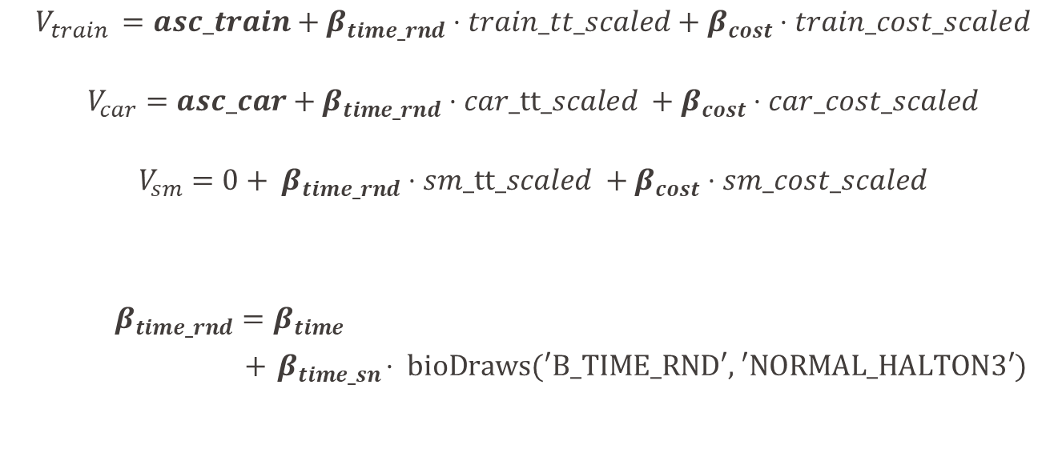
Utilities
$$V_{train }=asc_train+β_{time_rnd}⋅train_tt_scaled+β_{cost}⋅train_cost_scaled$$
$$V_{car}=asc_car+β_{time_rnd}⋅car_tt_scaled +β_{cost}⋅car_cost_scaled$$
$$V_{sm}=0+ β_{time_rnd}⋅sm_tt_scaled +β_{cost}⋅sm_cost_scaled$$
$β_{time_rnd}=β_{time}$
$+{ β}_{time_sn}⋅ \text{bioDraws}\text{(′}\text{B}\text{_}\text{TIME}\text{_}\text{RND}\text{′, ′}\text{NORMAL}\text{_}\text{HALTON}\text{3′)}$
Notes:
Instead of assuming fixed effect for travel time, i.e. assuming that βtime rnd is constant across
all individuals, the model allows for the possibility that different individuals have different
sensitivities or preferences travel time. This reflects the heterogeneity in preferences or behaviors
across the sample

Slide 9
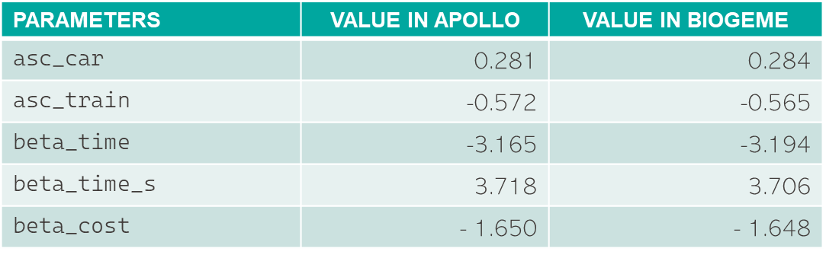
Estimation and statistics (100 draws)
PARAMETERS | VALUE IN APOLLO | VALUE IN BIOGEME
asc_car | 0.281 | 0.284
$$\text{asc}\text{_}\text{train}$$ | -0.572 | -0.565
$$\text{beta}\text{_}\text{time}$$ | -3.165 | -3.194
beta_time_s | 3.718 | 3.706
beta_cost | - 1.650 | - 1.648
 | VALUE IN APOLLO | VALUE IN BIOGEME
Initial Loglikelihood | - 5’782.84 | -5’784.81
Final Loglikelihood | - 4’363.05 | - 4’362.97
Notes:
Not sure whether this is relevant, maybe just say got same results in both Apollo/Biogeme go through the slide quickly)

Slide 10
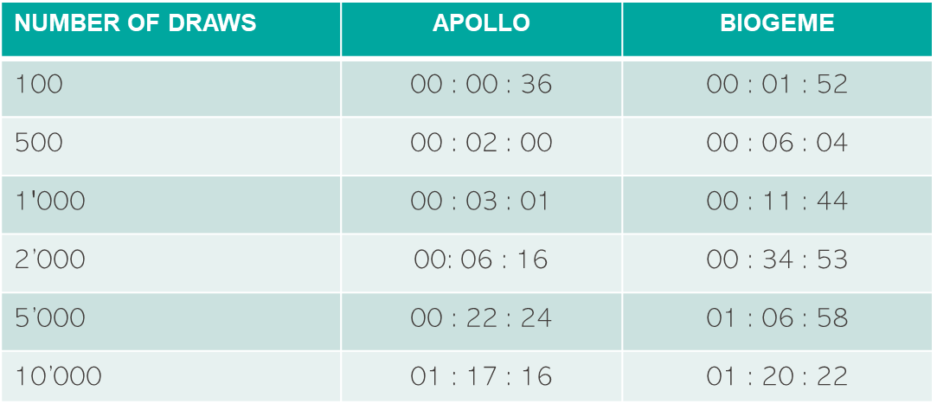
Estimation time
NUMBER OF DRAWS | APOLLO | BIOGEME
100 | 00 : 00 : 36 | 00 : 01 : 52
$$\text{500}$$ | 00 : 02 : 00 | 00 : 06 : 04
$$\text{1′000}$$ | 00 : 03 : 01 | 00 : 11 : 44
2’000 | 00: 06 : 16 | 00 : 34 : 53
5’000 | 00 : 22 : 24 | 01 : 06 : 58
10’000 | 01 : 17 : 16 | 01 : 20 : 22
Notes:
Not sure whether this is relevant, maybe just say got same results in both Apollo/Biogeme go through the slide quickly)

Slide 11
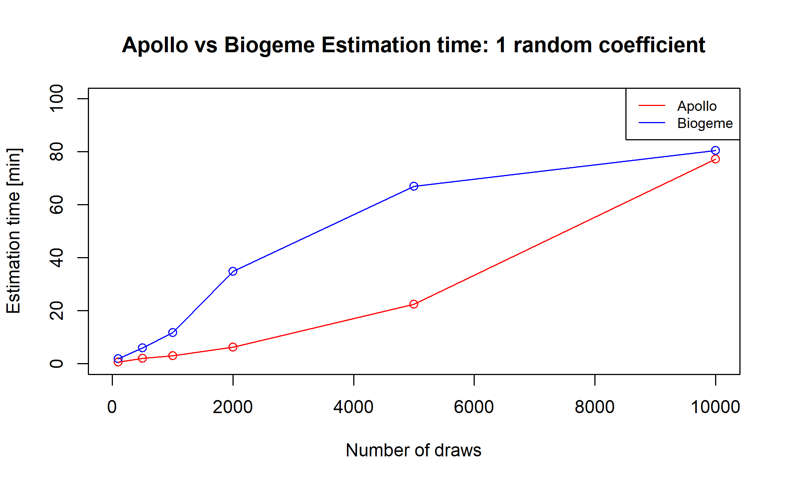
Draws Plot

Slide 12
Swissmetro 2
MMNL Model
4 random coefficients

Slide 13
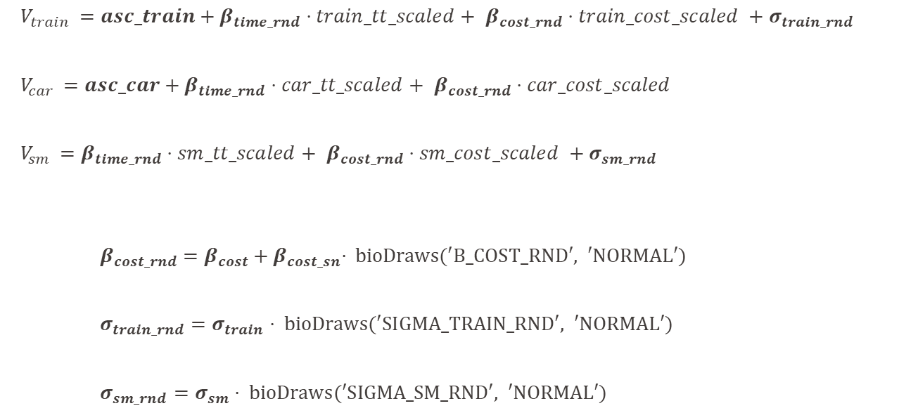
Utilities
$V_{train }=asc_train+β_{time_rnd}⋅train_tt_scaled+$ $β_{cost_rnd}⋅train_cost_scaled +σ_{train_rnd}$
$V_{car }=asc_car+β_{time_rnd}⋅car_tt_scaled+$ $β_{cost_rnd}⋅car_cost_scaled$
$V_{sm }=β_{time_rnd}⋅sm_tt_scaled+$ $β_{cost_rnd}⋅sm_cost_scaled +σ_{sm_rnd}$
$β_{cost_rnd}=β_{cost}+{ β}_{cost_sn}⋅ \text{bioDraws}\text{(′}\text{B}\text{_}\text{COST}\text{_}\text{RND}\text{′, ′}\text{NORMAL}\text{′)}$
$σ_{train_rnd}=σ_{train}⋅ \text{bioDraws}\text{(′}\text{SIGMA}\text{_}\text{TRAIN}\text{_}\text{RND}\text{′, ′}\text{NORMAL}\text{′)}$
$σ_{sm_rnd}=σ_{sm}⋅ \text{bioDraws}\text{(′}\text{SIGMA}\text{_}\text{SM}\text{_}\text{RND}\text{′, ′}\text{NORMAL}\text{′)}$
Notes:
Instead of assuming fixed effect for travel time, i.e. assuming that βtime rnd is constant across
all individuals, the model allows for the possibility that different individuals have different
sensitivities or preferences travel time. This reflects the heterogeneity in preferences or behaviors
across the sample

Slide 14
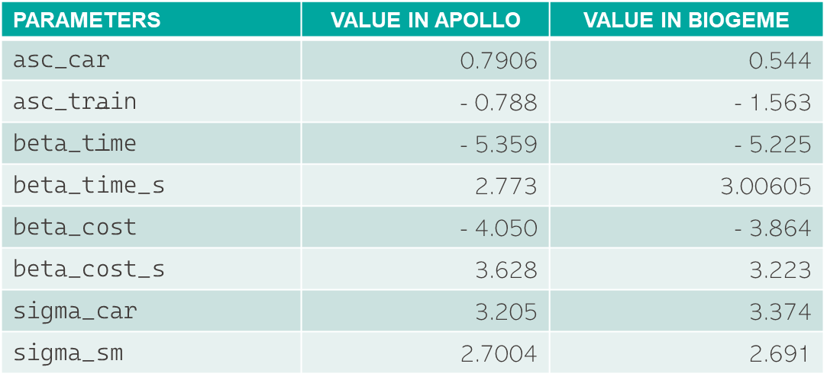
Estimation and statistics (100 draws)
PARAMETERS | VALUE IN APOLLO | VALUE IN BIOGEME
asc_car | 0.7906 | 0.544
$$\text{asc}\text{_}\text{train}$$ | - 0.788 | - 1.563
$$\text{beta}\text{_}\text{time}$$ | - 5.359 | - 5.225
beta_time_s | 2.773 | 3.00605
beta_cost | - 4.050 | - 3.864
beta_cost_s | 3.628 | 3.223
sigma_car | 3.205 | 3.374
sigma_sm | 2.7004 | 2.691
 | VALUE IN APOLLO | VALUE IN BIOGEME
Initial Loglikelihood | - 4’851.99 | -4896.67
Final Loglikelihood | -3’603.42 | - 3’603.30
Notes:
Not sure whether this is relevant, maybe just say got same results in both Apollo/Biogeme go through the slide quickly)

Slide 15
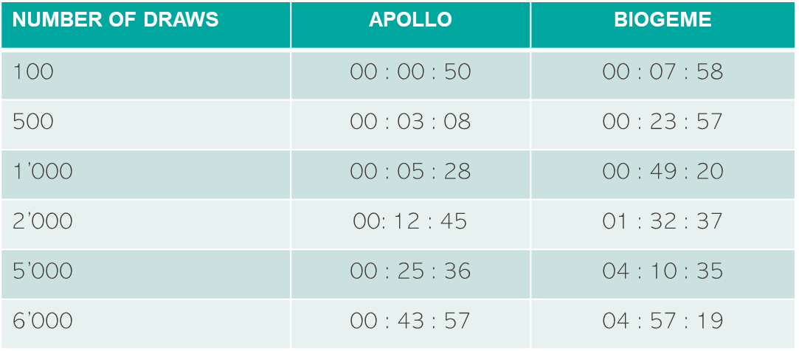
Estimation time
NUMBER OF DRAWS | APOLLO | BIOGEME
100 | 00 : 00 : 50 | 00 : 07 : 58
$$\text{500}$$ | 00 : 03 : 08 | 00 : 23 : 57
1’000 | 00 : 05 : 28 | 00 : 49 : 20
2’000 | 00: 12 : 45 | 01 : 32 : 37
5’000 | 00 : 25 : 36 | 04 : 10 : 35
6’000 | 00 : 43 : 57 | 04 : 57 : 19
Notes:
Not sure whether this is relevant, maybe just say got same results in both Apollo/Biogeme go through the slide quickly)

Slide 16
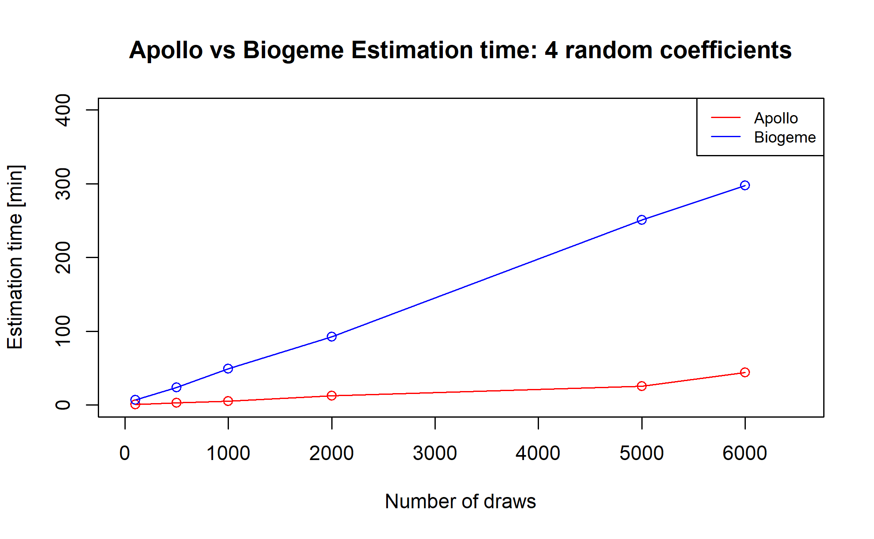
Draws Plot

Slide 17
Problems encountered
APOLLO:
Error in Apollo: “Model diagnosis: False convergence”
⇨ change from BGW to BFGS
Crashing issues for >7000 draws (swissmetro 2)
⇨ other computer: RAM error
BIOGEME:
Equivalence error for >1 random coefficient
⇨ change from “NORMAL_HALTON3” to “NORMAL”

Slide 18
CPU / RAM usage
MMNL Preference Space &
Swissmetro

Slide 19
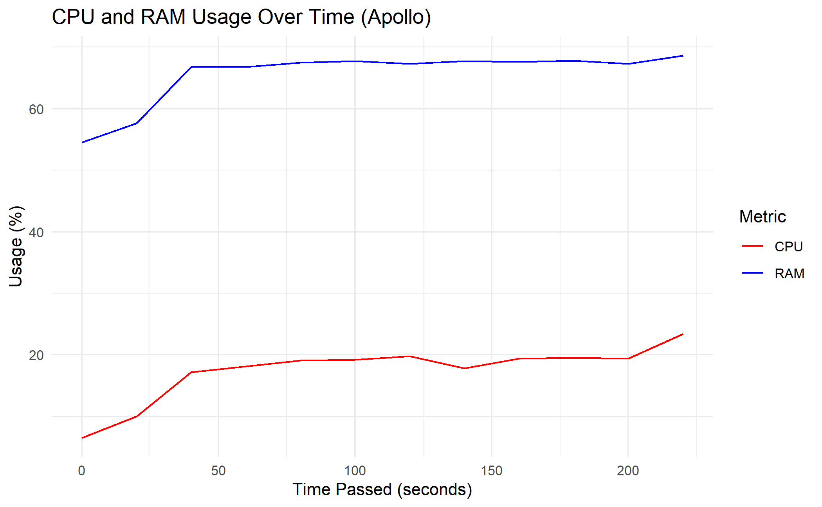
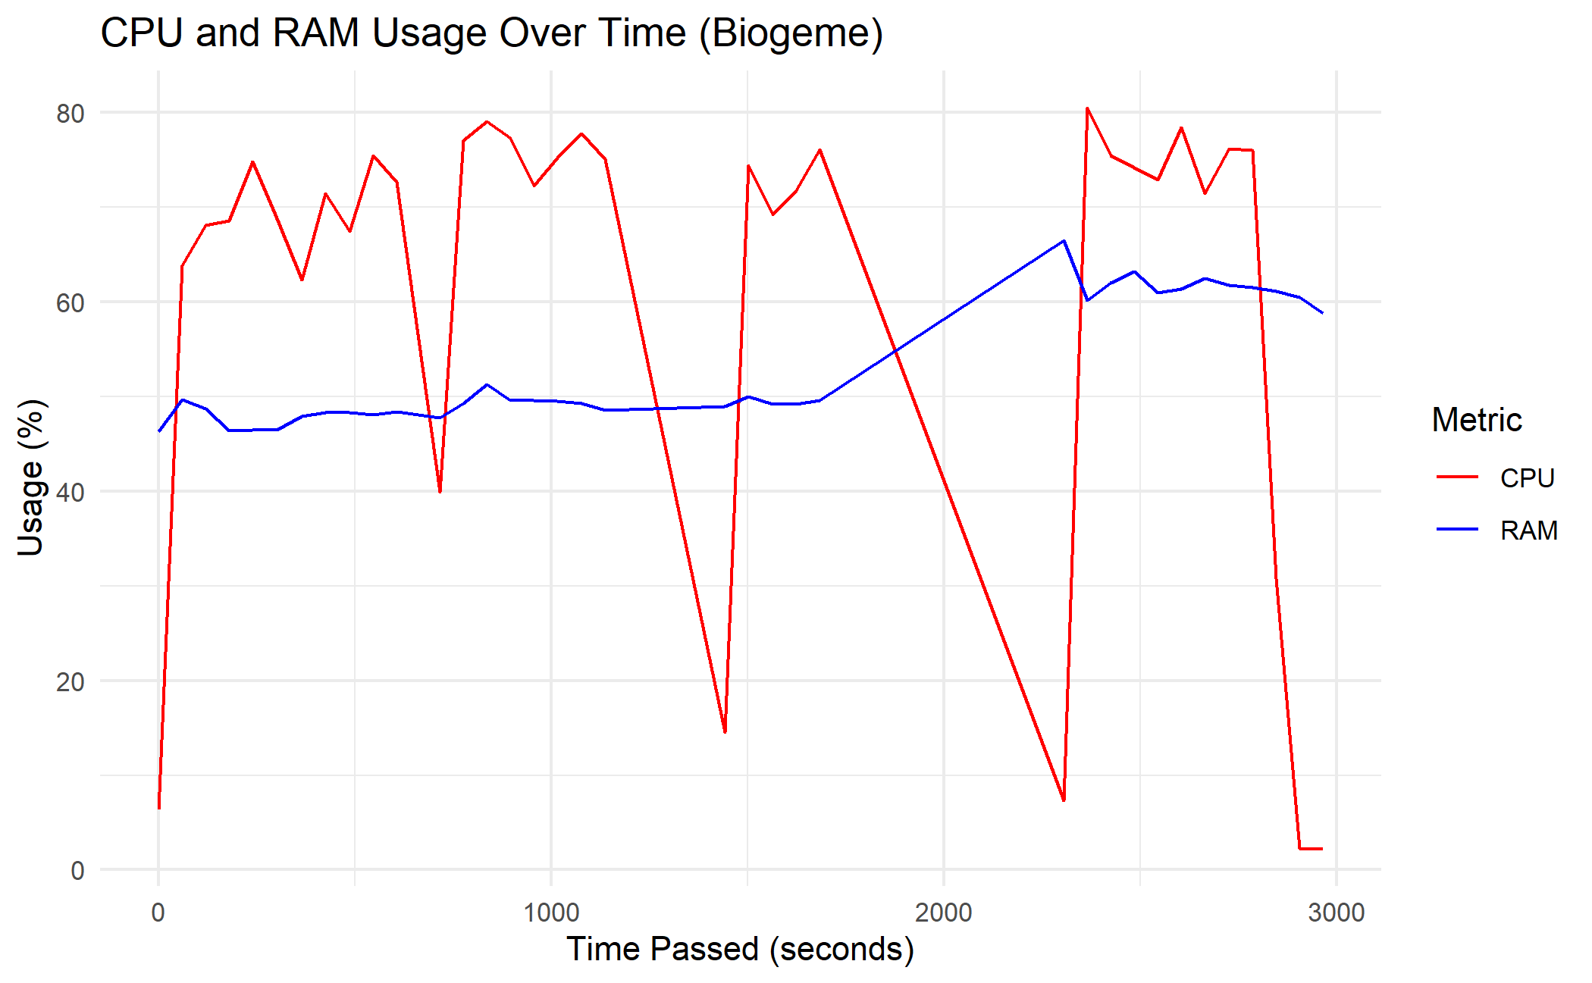
MMNL Preference Space
Apollo: 20 secs / 4mins Biogeme: 1 min/ 50mins

Slide 20
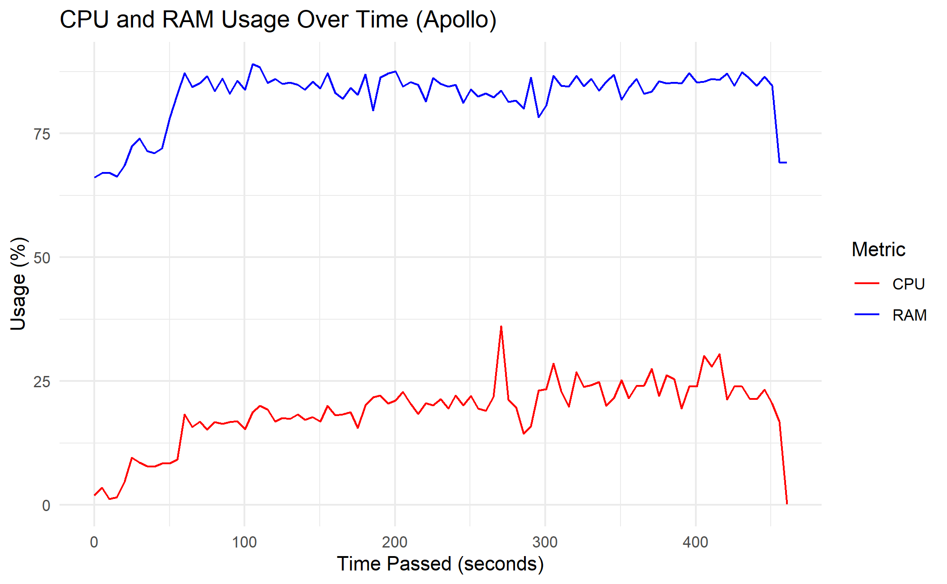
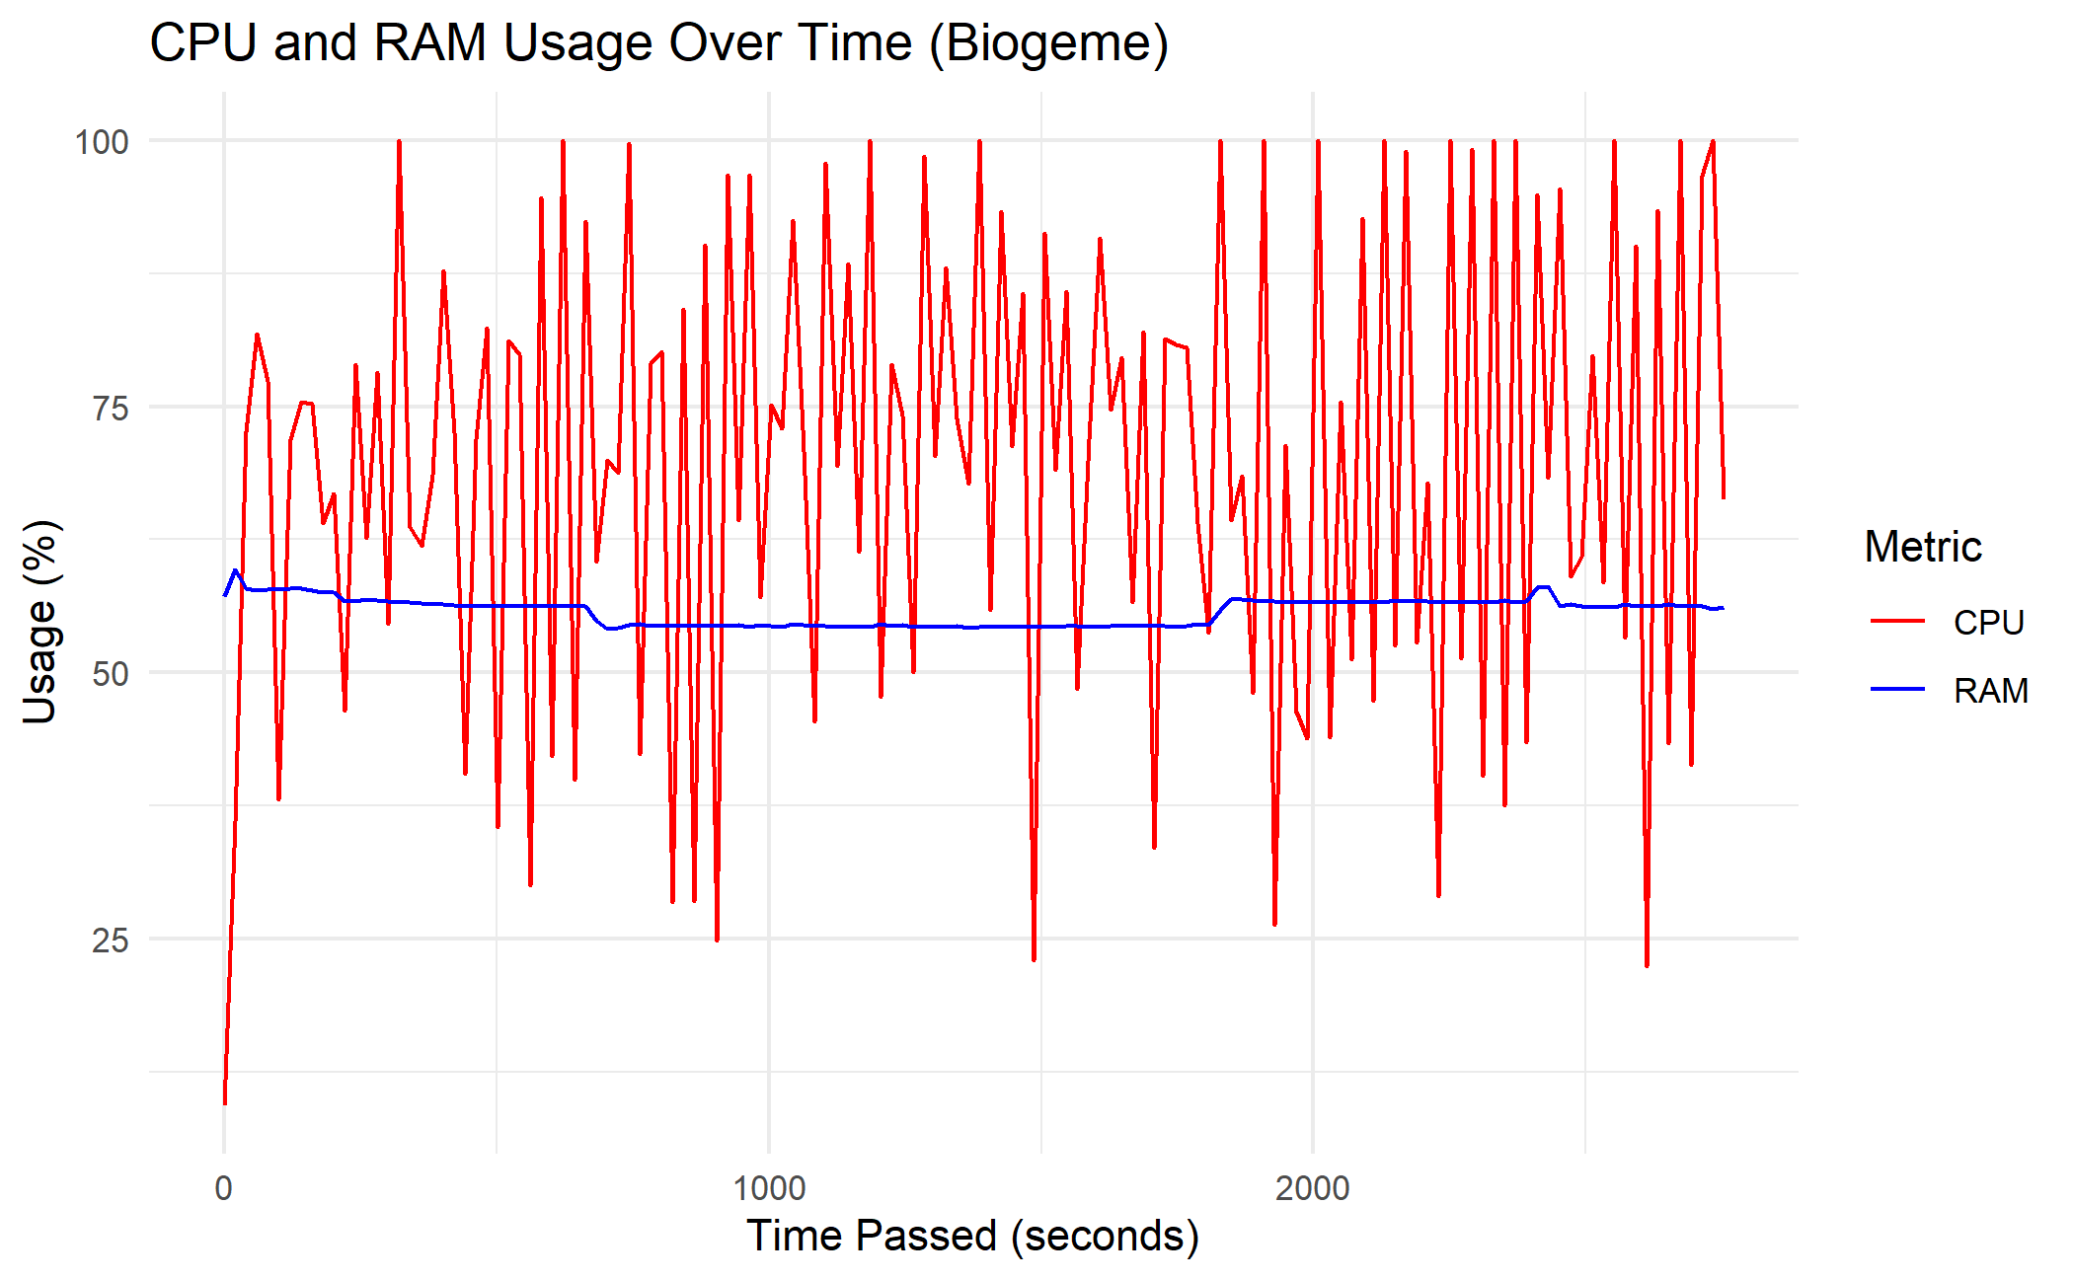
Swissmetro 2 (1000 draws)
Apollo: 5 secs / 10mins Biogeme: 20 seconds / 55mins
Notes:
Wanted to be more precise

Slide 21
General statistics (swissmetro 2)
 | MEAN | MEDIAN | VARIANCE | MAX
CPU APOLLO | 18.87 | 20.00 | 43.84 | 36.10
CPU BIOGEME | 69.41 | 71.65 | 500.70 | 100.00
RAM APOLLO | 82.65 | 84.70 | 30.64 | 89.00
RAM BIOGEME | 55.74 | 56.20 | 1.52 | 59.70

Slide 22
Features comparaison

Slide 23
Estimation features in Apollo
apollo_basTest(): Ben-Akiva & Swait test, more flexible
apollo_choiceAnalysis(): compares market shares across subsamples in dataset, conducts statistical tests
apollo_sharesTest(): compare shares predicted with shares observed, conducts statistical tests
apollo_fitsTest(): compares fit of estimated parameters with data subsets

Slide 24
Conclusion

Slide 25
Biogeme slower than Apollo
CPU solicited in Biogeme, RAM in Apollo
Investigation: error in Biogeme with the multiple random coefficients

Slide 26
Thank you for listening !

Slide 27
References
Hess, S. & Palma, D. (2019), Apollo: a flexible, powerful and customisable freeware package for choice model estimation and application, Journal of Choice Modelling
Michel Bierlaire (2023), A Short introduction to Biogeme
Michel Bierlaire (2023), École Polytechnique Fédérale de Lausanne, Biogeme Sphinx Documentation [https://biogeme.epfl.ch/sphinx/]
Axhausen, K. W. , Bierlaire, M. , & Abay, G. (2001), The acceptance of modal innovation, The case of Swissmetro

